Slide 1
The Global Technology and Engineering Consortium (GTEC
Partnering with STEM Corporations
MassCUE/M.A.S.S. Conference
October 26, 2011

Slide 2
Topics for today
GTEC – a brief overview
GTEC Global Virtual STEM Classroom concept & background
Pilot Program: Year One 2010-2011
Pilot Program: Year Two 2011-2012
Parametric Technology Corporation – GTEC partner
21st Century Skills & Building a partnership with STEM corporations
Next steps & how your school can participate

Slide 3
Introductions
GTEC Executive Board:
Isa Kaftal Zimmerman, Principal, IKZ Advisors, Former Superintendent of Schools
Annamaria Schrimpf, Director of Educational Technology, Winchester Public Schools
Larisa K. Schelkin, Executive Director, Founder and Concept Author
GTEC Partner: PTC
Myron Moss, Dima Orlov, Mark Fischer

Slide 4
GTEC – a brief overview
The Global Technology & Engineering Consortium (brings together K-12 & institutions of higher education, business & industry partners to contribute to developing the 21st century global workforce.
The Consortium will enable next generation workforce to be effective in & with other countries/cultures in solving the problems urgently confronting the world’s populations & working successfully across global cultural differences.

Slide 5
GTEC Global Virtual STEM Classroom concept & components
Concept developed 2007-2010:
K-12 (US and global)
Higher ed (US and global)
Partnering with STEM industry/corps (US and global)
GTEC Global Virtual STEM Classroom
Global team-work & intercultural communication
Project-based

Slide 6
Pilot First Year 2010-2011
Presented at MassCUE/M.A.S.S. last year
First year pilot program participants:
Spirit of Knowledge Public Charter School (Worcester, MA)
PTC (in US and UK);
Haywood College of Engineering (HS in UK)
Keele University/Staffordshire University (UK)
Olin College of Engineering
Worcester Polytechnic Institute
Newburyport High School

Slide 7
Pilot Year Two 2011-2012
Dennis Yarmouth High School
Spirit of Knowledge Charter School
Worcester Technical School (tentatively – TBC)
Becker College/MA Digital Institute
WPI
CISCO Foundation
A Computer gaming design company (TBD – FYI: 75 companies in MA)
A wind-turbine manufacturing co & MA Clean Energy Center (tentatively - TBC)
PTC (tentatively - TBC)

Slide 8
21st Century Skills: Building partnerships with STEM corporations
21st Century Skills:
Creativity, Learning & Innovation Skills;
Critical thinking & Problem Solving; Communication & Collaboration;
Life & Career Skills;
Information Literacy; Media Literacy; ICT Literacy;
Ethics & Empathy

Slide 9
Next steps
Successfully implementing the second pilot
Results presented via Global Virtual STEM Conference in late June 2012
Professional development workshops will be held at Olin College

Slide 10
How your school can participate
RFP for next year’s participation will be published at www.olin.edu/GTEC
Competitive review process
If chosen, your school will be connected with –
- a global school partner in Europe/Asia/South America or Australia
- a global STEM company
- higher education institution
- training will be provided to faculty & students
- STEM projects provided

Slide 11
Our contact information:
Larisa Schelkin: larisa.schelkin@gmail.com
Annamaria Schrimpf: aschrimpf@fc.masscue.org
Isa Zimmerman: ikz1@verizon.net

Slide 12
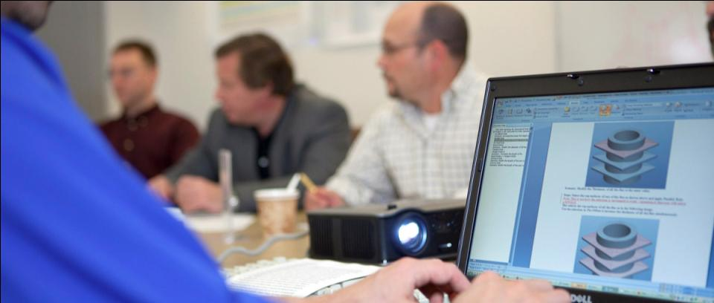
Who is PTC: The Product Development Company
PTC:
Our Customers:
  Boston-area, USA based Technology Leader
  in Product Development Software and Services
  World Leading Product Development Companies and Retail Establishments
  $1.02B
  Revenue in
  fiscal year 2010
  5000+
  employees in
  18 countries worldwide
  Outgrew Industry
  2004-2009 PTC PLM*
  27,000+ customers utilizing 600,000 active seats
  Winning
  22 strategic displacements in FY10- FY11
  4,000+
  new customers per year across 7 key industry verticals
*Source: AMR Research, CIMdata, IDC and company estimates
Notes:
As Technology leaders, PTC has the only integral Product Development System. [Hit the points noted under PDS]
And, Windchill growth has continued to surpass the PLM industry growth. [can talk to other points as well]
12

Slide 13





















































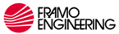

Unmatched Expertise in Multiple Vertical Markets
AEROSPACE & DEFENSE
ELECTRONICS
& HIGH TECH
RETAIL & CONSUMER
MEDICAL
DEVICES
AUTOMOTIVE
INDUSTRIAL
Notes:
13
PTC holds… title
PTC’s customers include some of the most recognized brands across broad industries

Slide 14

Engineer of the Future Program
Workforce Development
Newburyport
4th
STARBASE
5th
Scalextric4Schools
5th 10th
FIRST and RWDC
9th 12th
FSAE
K12
10.0 Million Students
45,000 Teachers
13th 16th
PTC University Design Challenge
13th 18th
Over 27,000 Customers
Universities
1,800 Universities
ATC
13th 18th
University Plus
Student Creo ‘Freemium’ Program
Creo Stair-Step Curriculum
Mathcad
Precision LMS
Windchill
Need for Engineers:
China= 5M by 2020
India= 3M by 2020
US= 3M by 2020
Germany= .5M by 2018
Russia= 2M by 2020
WORKFORCE DEVELOPMENT

Slide 15

Culture of Community and Philanthropy
PTC Global Academic Program – Engineer of the Future
  30
  countries
  45,000
  teachers
  25,000
  secondary schools
  1,800 universities
  10 million
  students
COMMUNITY AWARDS & RECOGNITION
  Mass High Tech Citizenship Award
  2003-2009
  BusinessWeek:
  Highest In-kind Giver for Software Companies
  2006
  International Technology Educators Association Award
  2007
  Congressional Medal of Honor Society Award
  2008
  Junior Achievement Boston Business
  Hall of Fame
  2010
Notes:
PTC is focused on the same mission as our customers: to continue to inspire the next generation of engineers - through two programs:
PTC Global Academic Program- The PTC Global Academic Program began in 1999 as a way to help teachers and professors bridge the gap between education and industry. PTC is actively working with industry, plus secondary school teachers and university professors to develop a complete education solution - from the secondary school all the way to the college/university level.
PTC programs have been recognized publicly receiving several awards over the years.
15

Slide 18
GTEC STEM Corporation partner:
PTC– Parametric Technology Corporation
(www.ptc.com)

Slide 19
An overview of PTC
Billion $ worldwide publicly traded company producing software that designs everything from NASA rockets to Audi automobiles to John Deere tractors

Slide 20
Educational component of PTC & need for engineers
Vacuum of engineers:
•an aging workforce
•most engineering jobs with US government, particularly those focusing on national defense, require U.S.citizenship
U.S. not producing enough new engineers for positions available

Slide 21
Educational component of PTC & need for engineers.2
PTC sells its software to:
•colleges & universities
•high & middle schools
•design software is free to those schools
•all licensing is free in perpetuity
• students encouraged to place software on their home computers
•free online training for teachers

Slide 22
What PTC software offers students
Based on classroom observations & in pilot, working with PTC's software in schools:
•Students, male & female, as early as 4th grade, easy to learn software
•The software challenges the gifted student, unlocks potential

Slide 23
Upcoming Conference @ PTC
Partnerships for Advancing Global Education(PAGE) on April 4, 2012 at PTC world headquarters in Needham.
The topic of the conference:
Preparing Our Students for 21st Century Competition in the Global Market.

