Slide 1
Commonwealth of Massachusetts STEM Advisory Council
Moving the STEM Agenda Forward
STEM Advisory Council
Full Council Meeting
September 26th, 2018

Slide 2
Welcome
Welcome Agenda Overview Updates Goals & Priorities Wrap Up
Welcome from the Co-Chairs
Lt. Governor Karyn Polito
Congressman Joseph Kennedy III (by phone)
Dr. Jeff Leiden

Slide 3
Agenda Overview
Welcome Agenda Overview Updates Goals & Priorities Wrap Up
Welcome (5 minutes)
Update and Discussion on Key Initiatives (20 minutes)
Secretary Peyser and Alexis Lian
STEM Early College & Innovation Pathways Update
STEM@Work
FY19 STEM Pipeline Fund Budget
Discussion on STEM Week (30 minutes)
Secretary Peyser and Alexis Lian
STEM Council Members Report Out
Event Planning
Communications and Outreach
Promotional Videos
Approval of Minutes from January 25, 2018 Meeting (1 minute)
Wrap Up and Next Steps (5 minutes)

Slide 4
STEM Advisory Council Priorities
Welcome Agenda Overview Updates Goals & Priorities Wrap Up
Updates
1. Foundational Skill Building Updates
Project Lead the Way
PLTW will have over 200 schools and approximately 35,000 students participating in programming this year
Upcoming events:
10/12 State Networking Conference at WPI
11/8 STEM College & Career Fair at Chelmsford High School
3/5 Convening for New Grant Schools
Computer Science Updates
A shift of MassCAN over to EOE is in process, including the hiring of an Executive Director

Slide 5
STEM Advisory Council Priorities
Welcome Agenda Overview Updates Goals & Priorities Wrap Up
Updates
2. High-Quality, Integrated STEM Pathways
Early College
Final Designees- approved by the Early College Joint Committee on April 26.
Final Designees- approved by the Early College Joint Committee on July 17.
 | K-12 Partner | Higher Education Partner
1 | Charlestown High School | Bunker Hill Community College
2 | Chelsea High School | Bunker Hill Community College
3 | Holyoke Public Schools | Holyoke Community College
4 | New Heights Charter School of Brockton | Massasoit Community College
5 | Salem Public Schools | Salem State University
 | K-12 Partner | Higher Education Partner
1 | Westfield Promise (Westfield, Holyoke, and Springfield Public Schools) | Westfield State University
2 | Lawrence Public Schools | Merrimack College
3 | Lawrence Public Schools | Northern Essex CC
4 | Worcester Public Schools | Quinsigamond CC and Worcester State University

Slide 6
STEM Advisory Council Priorities
Welcome Agenda Overview Updates Goals & Priorities Wrap Up
Updated STEM Council Vision
Ensure that all students develop foundational skills in STEM subjects throughout their PK-12 experience, including frequent opportunities for relevant, hands-on learning that aligns topics across STEM subjects and connects to other parts of the curriculum (e.g., the Arts), in order to prepare them for post-secondary studies and entry-level career opportunities, regardless of their academic or occupational focus.
Increase awareness and interest in STEM careers among students and parents, and develop high-quality, integrated STEM pathways from secondary school to college – including relevant career guidance and exploration, workplace experiences, and applied learning across all STEM subjects (including math) – to ensure that more high school graduates, especially those from historically under-represented populations, are ready to pursue STEM majors in higher education and technical careers in STEM fields.
Deepen partnerships among employers, vocational-technical schools, community colleges, universities, and adult education providers to promote career opportunities in STEM fields and to create scalable post-secondary STEM programs for adult learners and incumbent workers to provide more high-quality STEM career on-ramps and on-the-job training opportunities that are responsive to needs of employers.

Slide 7
STEM Advisory Council Priorities
Welcome Agenda Overview Updates Goals & Priorities Wrap Up
Updates
2. High-Quality, Integrated STEM Pathways
Innovation Pathways
Final Designees approved in April 2018.
Final Designees approved in July 2018.
 | K-12 Partner | Employer and Higher Ed Partners
1 | Nantucket Public Schools | Nantucket Cottage Hospital Egan Maritime Institute UMass-Boston Nantucket Field Station
2 | Northampton Public Schools | Tech Foundry Franklin-Hampshire Regional Employment Board Greenfield Community College
3 | Uxbridge Public Schools | Blackstone Valley Chamber of Commerce MassSTEM Hub Quinsigamond Community College
4 | Worcester Public Schools | Central Massachusetts Workforce Dev. Board Worcester Regional Chamber of Commerce Quinsigamond Community College
 | K-12 Partner | Employer and Higher Ed Partners
1 | Everett Public Schools | Now Business Intelligence (NBI) Bunker Hill Community College
2 | Tewksbury Public Schools | Greater Lowell WDB Thermo Fisher Scientific Middlesex Community College
3 | Northbridge Public Schools | Blackstone Valley Chamber of Commerce Quinsigamond Community College

Slide 8
STEM Advisory Council Priorities
Welcome Agenda Overview Updates Goals & Priorities Wrap Up
Updates
3. Deepening Partnerships with Employers
MA STEM@Work
 | Grant Recipients | Non-Grant Recipients | Total
# of New Employers Recruited to Host | 84 | 48 | 132
# of New Student Internship Slots | 217 | 77 | 294

Slide 9
Discussion on FY18-FY19 Goals
Welcome Agenda Overview Updates Goals & Priorities Wrap Up
FY19 STEM Pipeline Fund Budget
FY19 STEM Pipeline Fund Budget | Proposed Amount
2018 STEM Summit | $50,000
STEM@Work Recruitment | $250,000
Curriculum Development & Teacher Training | $350,000
STEM Council Staffing | $150,000
STEM Pathway Planning & Implementation | $500,000
Alignment/Acceleration Initiatives *This includes potential Regional STEM Network FY19 funding to support FY20 STEM Week purposes | $ 200,000
Total | $1,500,000

Slide 10
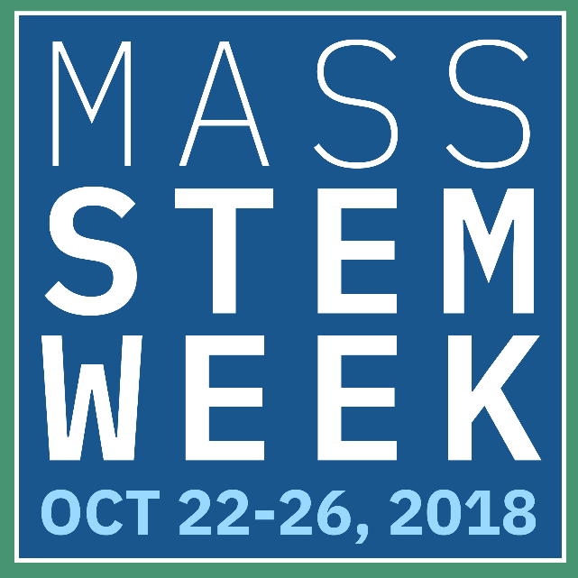
STEM Advisory Council Priorities
Welcome Agenda Overview Updates Goals & Priorities Wrap Up
In order to highlight the connection of strong STEM education to a talented and skilled workforce, Governor Baker and Lt. Governor Polito, in collaboration with the STEM Advisory Council, are planning a statewide “STEM Week” from October 22-26, 2018.
During STEM Week, schools will be able to highlight specific week-long STEM curriculum (i.e., i2 Learning), special classes on particular days or showcase efforts already underway (i.e., Project Lead The Way courses). STEM Week activities will encompass Pre-K – grade 12 learning, with a particular emphasis on middle and high school STEM courses.
Additionally, during STEM week, at least one member of the Administration or STEM Council Executive Committee will visit classrooms and/or school-related STEM activities (e.g., STEM@Work internships, job shadows, etc.) each day.

Slide 11
STEM Advisory Council Priorities
Welcome Agenda Overview Updates Goals & Priorities Wrap Up
STEM Council Member Report Out
STEM Council members who’ve been involved in the planning or execution of a STEM Week event, we’d love to hear your updates!

Slide 12
STEM Week
Welcome Agenda Overview Vision Get Involved Wrap Up
Events Planning
More than 250 STEM Week events currently planned/on the radar of the Regional STEM Networks
Berkshire:
Interactive/Engineering Expo with General Dynamics at MCLA
Lecture for Educators on Science Teaching Pedagogy at MCLA
Cape Cod:
Blue Economy Film and Discussion with CEO of McLane Labs at Barnstable High School
Tour of regional STEM employers for educators (Bourne, Woods Hole, Falmouth)
Central MA:
STEM Career Expo for Families (Fitchburg/Leominster Boys and Girls Club and Worcester Boys and Girls Club)
Blackstone Valley STEM Career Expo and Hands-On Demonstrations for Middle School Students (Cummings School of Veterinary Medicine)
Boston:
Design Challenge for students from 3 BPS High Schools (IDEO, Cambridge)
i2 Learning in 30 BPS Schools
MetroNorth:
Science from Scientists Hands-On Lessons (Revere and Malden)
Project Lead The Way Expo/Demonostration for Middle School students with High School students (Watertown)
MetroWest:
Moon Landing in Context with Congressman Kennedy (Framingham State University)
Space Mission Simulation in collaboration with U.S. Army Natick Research, Development & Engineering Center (Framingham State University)
Northeast:
Makerspace design challenge for middle schools students (Wakefield)
Robotics and Digital Learning Demonstrations with Amazon Robotics (North Reading)
Southeast:
Early Childhood program to focus on building a plan with candy (Bristol-Plymouth)
Cranberry Bog Classroom Designed by Middle School Students (Wareham)

Slide 13
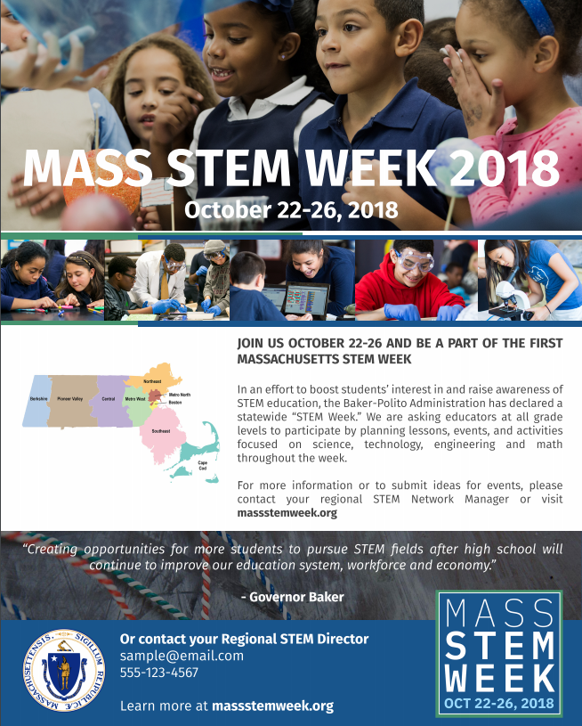
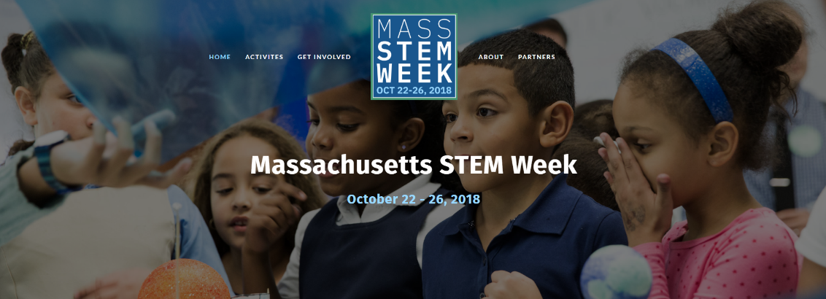
STEM Week
Welcome Agenda Overview Vision Get Involved Wrap Up
Communications and Outreach
STEM Week Flyer
Outreach
STEM Week Website:
www.Massstemweek.org
Kick-Off Event and Proclamation Signing:
Monday, October 22nd at 11am
Promotional Videos

Slide 14
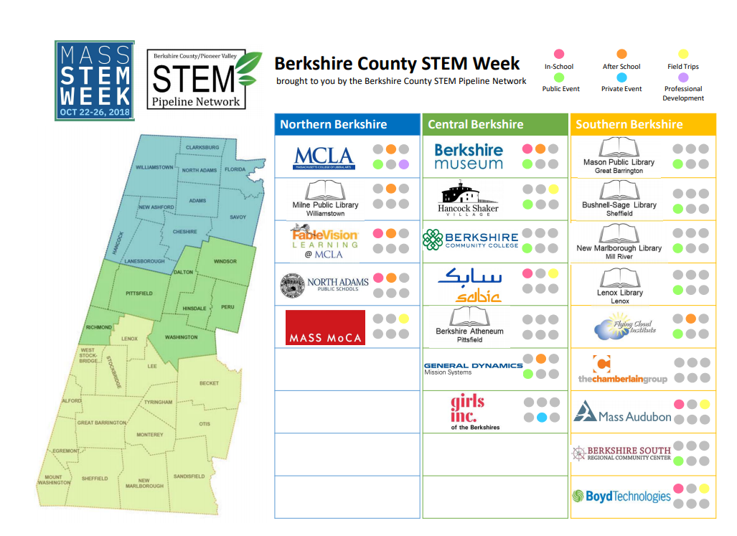
STEM Week
Welcome Agenda Overview Vision Get Involved Wrap Up
Events Planning
Each region is doing their own local promotion and outreach as well
Many regions, like in the Berkshires, are creating a schedule of events one-pager

Slide 15
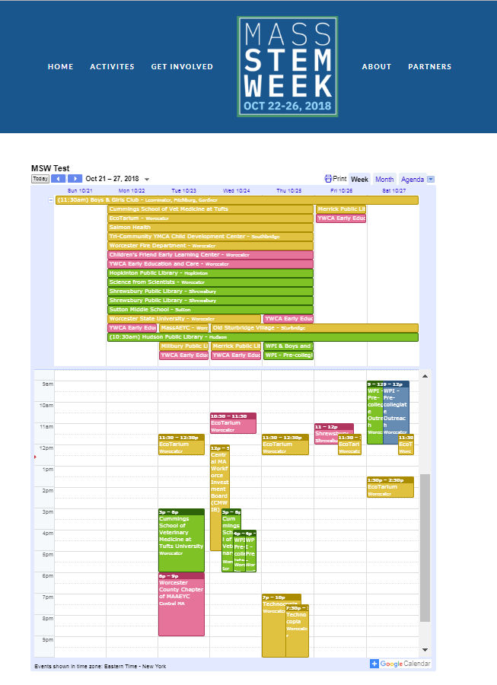
STEM Week
Welcome Agenda Overview Vision Get Involved Wrap Up
Events Planning
Each region will have a Google Calendar linked to their geographic location.
Each event will contain a description about the intended audience, grade-level or position focus, date, time, event location, and a short event description
Grade level is filtered by color (e.g. green events are elementary and middle-focused, pink are early education-focused, etc.)

Slide 16
STEM Week Timeline
Welcome Agenda Overview Vision Get Involved Wrap Up
STEM Council Executive Committee Meeting
STEM Council Executive Committee Meeting
STEM Council Full Committee Meeting
STEM Week Reflection Session at the STEM Summit
&
Letter to Superintendents about STEM Week
Regional STEM Network Managers Meeting
2nd STEM Week Subcommittee Meeting
Release Letters to the Editor, relevant Op-ed, related press releases
April
May
June
July
August
September
October
November
Regional STEM Network Managers Check-In and Brainstorm
STEM Week Website functional with confirmed events and location details
Inaugural Massachusetts STEM Week
1st STEM Week Subcommittee Meeting
Confirmed STEM Week Events Submission Date
*Events to date

Slide 17
STEM Week
Welcome Agenda Overview Vision Get Involved Wrap Up
How Can I Get Involved?
Contact a Regional STEM Network Manager
For all events taking place regionally
Contact Alexis Lian or Blair Brown
For all events taking place state-wide, or for general questions
Hub | Contact Name | Email
Berkshire/ Pioneer Valley | Monica Joslin | M.Joslin@mcla.edu
Boston | Hilary Brayton | Hilary.Brayton@bostonpic.org
Metro North | Ben Christensen | bchristensen@mnreb.org
Central MA | Kathy Chen | kcchen@wpi.edu
Metro West | Irene Porro | iporro@Framingham.edu
Cape Cod | Bridget Burger | bburger@capecod.edu
Southeast | Stacey Kaminski, Katherine Honey | Stacey.kaminski@connectsemass.org khoney@Comcast.net
Northeast | Christine Shaw, Gail Gasparich | shawc@Merrimack.edu ggasparich@salemstate.edu
Alexis Lian | Alexis.Lian@mass.gov
Blair Brown | Blair.Brown@mass.gov

Slide 18
Wrap Up
Welcome Agenda Overview Updates Goals & Priorities Wrap Up
Wrap Up and Next Steps

